Slide 1

مبانی داده کاوی
خوشه بندی
بهشیـد بهکمـال
نیمسال اول 1400-1399

Slide 2
Outline
Cluster Analysis: Basic Concepts
Clustering Methods
Partitioning Methods
Hierarchical Methods
Density-Based Methods
Grid-Based Methods
Summery
Notes:
2

Slide 3
What is Cluster Analysis?
Unsupervised learning
Cluster: A collection of data objects
similar (or related) to one another within the same group
dissimilar (or unrelated) to the objects in other groups
Cluster analysis (or clustering, data segmentation, …)
Finding similarities between data according to the characteristics found in the data and grouping similar data objects into clusters
Typical applications
As a stand-alone tool to get insight into data distribution
As a preprocessing step for other algorithms

Slide 4
What is Cluster Analysis?
is also called as:
Automatic classification
Data segmentation
Learning by observation
What is not clustering?
Supervised classification
Simple segmentation/grouping
Results of a query

Slide 5
Clustering for Data Understanding and Applications
Biology: taxonomy of living things
Information retrieval: document clustering
Land use: Identification of areas of similar land use in an earth observation database
Marketing: Help marketers discover distinct groups in their customer bases
City-planning: Identifying groups of houses
Climate: understanding earth climate, find patterns of atmospheric and ocean

Slide 6
Clustering as a Preprocessing Tool (Utility)
Summarization/Sampling:
Preprocessing for regression, PCA, classification, and association analysis
Compression:
Image processing: vector quantization
Finding K-nearest Neighbors
Localizing search to one or a small number of clusters
Outlier detection
Outliers are often viewed as those “far away” from any cluster

Slide 7
Quality: What Is Good Clustering?
A good clustering method will produce high quality clusters
high intra-class similarity: cohesive within clusters
low inter-class similarity: distinctive between clusters

Slide 8
Quality of Clustering
The quality of a clustering method depends on
the similarity measure used by the method, and
its ability to discover some or all of the hidden patterns
Dissimilarity/Similarity metric
Similarity is expressed in terms of a distance function, typically metric: d (i, j)
The definitions of distance functions are usually rather different for interval-scaled, boolean, categorical, ordinal ratio, and vector variables
Quality of clustering
Using “quality” function to measure the “goodness” of a cluster
It is hard to define “similar enough” or “good enough”

Slide 9
Considerations for Cluster Analysis
Partitioning criteria
Single level vs. hierarchical partitioning (often, multi-level hierarchical partitioning is desirable)
Separation of clusters
Exclusive (one customer belongs to only one region) vs. non-exclusive (e.g., one document may belong to more than one class)
Similarity measure
Distance-based (e.g., Euclidian, road network, vector) vs. connectivity-based (e.g., density or contiguity)
Clustering space
Full space (often when low dimensional) vs. subspaces (often in high-dimensional clustering)

Slide 10
Requirements and Challenges
Scalability
Clustering all the data instead of only on samples
Ability to deal with different types of attributes
Numerical, binary, categorical, ordinal, linked, and mixture of these
Constraint-based clustering
User may give inputs on constraints
Use domain knowledge to determine input parameters
Interpretability and usability
Others
Discovery of clusters with arbitrary shape
Ability to deal with noisy data
Incremental clustering and insensitivity to input order
High dimensionality

Slide 11
Major Clustering Approaches (I)
Partitioning approach
Construct various partitions and then evaluate the error
e.g. k-means, k-medoids, CLARANS
Hierarchical approach
Create a hierarchical decomposition of the set of data (or objects) using some criterion
e.g. DIANA, AGNES, BIRCH, CAMELEON
Density-based approach
Based on connectivity and density functions
e.g. DBSACN, OPTICS, DenClue
Grid-based approach
based on a multiple-level granularity structure
e.g. STING, WaveCluster, CLIQUE

Slide 12
Major Clustering Approaches (II)
Model-based
A model is hypothesized for each of the clusters and tries to find the best fit of that model to each other
e.g. EM, SOM, COBWEB
Frequent pattern-based
Based on the analysis of frequent patterns
e.g. p-Cluster
User-guided or constraint-based
Clustering by considering user-specified or application-specific constraints
e.g. COD (obstacles), constrained clustering
Link-based clustering
Objects are often linked together in various ways
e.g. SimRank, LinkClus

Slide 13
1. Partitioning Clustering
Partitioning method: Partitioning a database D of n objects into a set of k clusters, such that the sum of squared distances is minimized (where c_{i} is the centroid or medoid of cluster C_{i})
Given k, find a partition of k clusters that optimizes the chosen partitioning criterion
k-means: Each cluster is represented by the center of the cluster
k-medoids or PAM (Partition around medoids): Each cluster is represented by one of the objects in the cluster

Slide 14
The K-Means Clustering Method
Given k, the k-means algorithm is implemented in four steps:
Partition objects into k nonempty subsets
Compute seed points as the centroids of the clusters of the current partitioning (the centroid is the center, i.e., mean point, of the cluster)
Assign each object to the cluster with the nearest seed point
Go back to Step 2, stop when the assignment does not change

Slide 15
An Example of K-Means Clustering
K=2
Arbitrarily partition objects into k groups
Update the cluster centroids
The initial data set
Loop if needed
Reassign objects
Update the cluster centroids

Slide 16
Comments on the K-Means Method
Strength: Efficient: O(tkn),
where n is # objects, k is # clusters, t is # iterations (Normally, k, t << n)
Comment: Often terminates at a local optimal.
Weakness
Applicable only to objects in a continuous n-dimensional space
Using the k-modes method for categorical data
In comparison, k-medoids can be applied to a wide range of data
Need to specify k, the number of clusters (there are ways to automatically determine the best k)
Sensitive to noisy data and outliers
Not suitable to discover clusters with non-convex shapes

Slide 17
What Is the Problem of the K-Means Method?
The k-means algorithm is sensitive to outliers !
Since an object with an extremely large value may substantially distort the distribution of the data
K-Medoids: Instead of taking the mean value of the object in a cluster as a reference point, medoids can be used, which is the most centrally located object in a cluster
10
10
9
9
8
8
7
7
6
6
5
5
4
4
3
3
2
2
1
1
0
0
1
2
3
4
5
6
7
8
9
10
0
0
1
2
3
4
5
6
7
8
9
10

Slide 18
PAM: A Typical K-Medoids Algorithm
Arbitrary choose k object as initial medoids
Assign each remaining object to nearest medoids
10
9
8
7
6
5
4
3
2
1
0
0
1
2
3
4
5
6
7
8
9
10
K=2
Randomly select a non-medoid object, O_{ramdom}
Swapping O and O_{ramdom}
If quality is improved.
10
10
9
9
8
Compute total cost of swapping
8
7
7
6
6
5
5
4
4
Do loop
Until no change
3
3
2
2
1
1
0
0
1
2
3
4
5
6
7
8
9
10
0
0
1
2
3
4
5
6
7
8
9
10
18
Notes:
18

Slide 19
The K-Medoid Clustering Method
K-Medoids Clustering: Find representative objects (medoids) in clusters
PAM (Partitioning Around Medoids)
Starts from an initial set of medoids and iteratively replaces one of the medoids by one of the non-medoids if it improves the total distance of the resulting clustering
PAM works effectively for small data sets, but does not scale well for large data sets (due to the computational complexity)
Efficiency improvement on PAM
CLARA (Kaufmann & Rousseeuw, 1990): PAM on samples
CLARANS (Ng & Han, 1994): Randomized re-sampling

Slide 20
2. Hierarchical Clustering
Use distance matrix as clustering criteria. This method does not require the number of clusters k as an input, but needs a termination condition
Step 0
Step 1
Step 2
Step 3
Step 4
agglomerative
(AGNES)
a
a b
b
a b c d e
c
c d e
d
d e
e
divisive
(DIANA)
Step 4
Step 3
Step 2
Step 1
Step 0

Slide 21
AGNES (Agglomerative Nesting)
Introduced in Kaufmann and Rousseeuw (1990)
Implemented in statistical packages, e.g., Splus
Use the single-link method and the dissimilarity matrix
Merge nodes that have the least dissimilarity
Go on in a non-descending fashion
Eventually all nodes belong to the same cluster

Slide 22
DIANA (Divisive Analysis)
Introduced in Kaufmann and Rousseeuw (1990)
Implemented in statistical analysis packages, e.g., Splus
Inverse order of AGNES
Eventually each node forms a cluster on its own

Slide 23
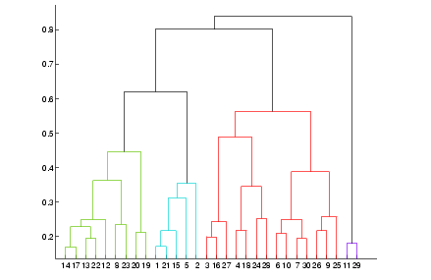
Dendrogram: Shows How Clusters are Merged

Slide 24
Distance between Clusters
Single link: smallest distance between an element in one cluster and an element in the other, i.e., dist(K_{i}, K_{j}) = min(t_{ip}, t_{jq})
Complete link: largest distance between an element in one cluster and an element in the other, i.e., dist(K_{i}, K_{j}) = max(t_{ip}, t_{jq})
Average: avg distance between an element in one cluster and an element in the other, i.e., dist(K_{i}, K_{j}) = avg(t_{ip}, t_{jq})
Centroid: distance between the centroids of two clusters, i.e., dist(K_{i}, K_{j}) = dist(C_{i}, C_{j})
Medoid: distance between the medoids of two clusters, i.e., dist(K_{i}, K_{j}) = dist(M_{i}, M_{j})
24
Notes:
24

Slide 25
Centroid, Radius and Diameter of a Cluster (for numerical data sets)
Centroid: the “middle” of a cluster
Radius: square root of average distance from any point of the cluster to its centroid
Diameter: square root of average mean squared distance between all pairs of points in the cluster
25
Notes:
25

Slide 26
3. Density-Based Clustering
Clustering based on density (local cluster criterion), such as density-connected points
Major features:
Discover clusters of arbitrary shape
Handle noise
One scan
Need density parameters as termination condition
Several interesting studies:
DBSCAN: Ester, et al. (KDD’96)
OPTICS: Ankerst, et al (SIGMOD’99).
DENCLUE: Hinneburg & D. Keim (KDD’98)
CLIQUE: Agrawal, et al. (SIGMOD’98) (more grid-based)

Slide 27
Density-Based Clustering: Basic Concepts
Two parameters:
Eps: Maximum radius of the neighbourhood
MinPts: Minimum number of points in an Eps-neighbourhood of that point
N_{Eps}(p): {q belongs to D | dist(p,q) ≤ Eps}
Directly density-reachable: A point p is directly density-reachable from a core point q if
p belongs to N_{Eps}(q)
core point condition:
|N_{Eps} (q)| ≥ MinPts
p
MinPts = 5
Eps = 1 cm
q

Slide 28
DBSCAN: Density-Based Spatial Clustering of Applications with Noise
Relies on a density-based notion of cluster: A cluster is defined as a maximal set of density-connected points
Discovers clusters of arbitrary shape in spatial databases with noise
Outlier
Border
Eps = 1cm
MinPts = 5
Core

Slide 29
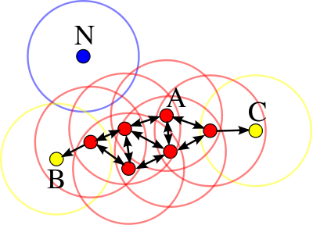
DBSCAN: Example
A: Core
B,C: Border
N: Outlier

Slide 30
Density-Reachable and Density-Connected
Density-reachable
A point p is density-reachable from a point q
Density-connected
A point p is density-connected to a point q
p
p₁
q
p
q
o

Slide 31
Density-Reachable and Density-Connected
m,p,o, r are core objects
Object q is directly density-reachable from m.
Object m is directly density-reachable from p and vice versa.
Object q is (indirectly) density-reachable from p because q is directly density-reachable from m and m is directly density-reachable from p. However, p is not density-reachable from q because q is not a core object.
r and s are density-reachable from o and o is density-reachable from r.
Thus, o, r, and s are all density-connected
MinPts =3

Slide 32
DBSCAN: The Algorithm
Arbitrary select a point p
Retrieve all points density-reachable from p w.r.t. Eps and MinPts
If p is a core point, a cluster is formed
If p is a border point, no points are density-reachable from p and DBSCAN visits the next point of the database
Continue the process until all of the points have been processed

Slide 33
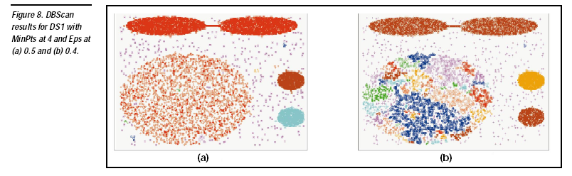

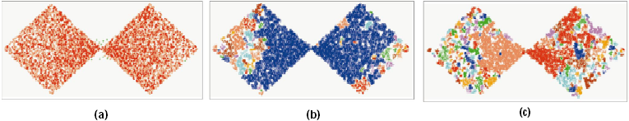
DBSCAN: Sensitive to Parameters

Slide 34
4. Grid-Based Clustering Method
Using multi-resolution grid data structure
Several interesting methods
STING (a STatistical INformation Grid approach) by Wang, Yang and Muntz (1997)
WaveCluster by Sheikholeslami, Chatterjee, and Zhang (VLDB’98)
A multi-resolution clustering approach using wavelet method
CLIQUE: Agrawal, et al. (SIGMOD’98)
Both grid-based and subspace clustering

Slide 35
STING: A Statistical Information Grid Approach
The spatial area is divided into rectangular cells
There are several levels of cells corresponding to different levels of resolution

Slide 36
The STING Clustering Method
Each cell at a high level is partitioned into a number of smaller cells in the next lower level
Statistical info of each cell is calculated and stored beforehand and is used to answer queries
Parameters of higher level cells can be easily calculated from parameters of lower level cell
count, mean, s, min, max
type of distribution—normal, uniform, etc.
Use a top-down approach to answer spatial data queries
Start from a pre-selected layer—typically with a small number of cells
For each cell in the current level compute the confidence interval

Slide 37
STING Algorithm and Its Analysis
Remove the irrelevant cells from further consideration
When finish examining the current layer, proceed to the next lower level
Repeat this process until the bottom layer is reached
Advantages:
Query-independent, easy to parallelize, incremental update
O(K), where K is the number of grid cells at the lowest level
Disadvantages:
All the cluster boundaries are either horizontal or vertical, and no diagonal boundary is detected

Slide 38
Comparison of clustering methods

Slide 39
Summary
Cluster analysis groups objects based on their similarity and has wide applications
Measure of similarity can be computed for various types of data
Clustering algorithms:
Partitioning methods:
K-means and K-medoids
Hierarchical methods:
AGNES and DIANA
Density-based methods:
DBSCAN
Grid-based methods:
STING

Slide 40


